Slide 1

Product Metrics for Software Engineering
Product metrics provide software engineers with quantitative ways to assess the quality of internal product attributes, enabling quality assessment before a product is built. This presentation explores various types of product metrics for requirements models, design, source code, testing, and maintenance. We'll examine how metrics can provide insights to create effective models, solid code, and thorough tests across different types of software systems.

Slide 2

Software Measurement
McCall’s quality factors were proposed in the early 1970s. They are as valid today as they were in that time. It’s likely that software built to conform to these factors will exhibit high quality well into the 21st century, even if there are dramatic changes in technology.

Slide 3
The Challenge of Product Metrics
1
Search for Comprehensive Metrics
2
Multiple Perspectives
Over the past four decades, many researchers have attempted to develop a single metric that provides a comprehensive measure of software complexity. Fenton characterizes this research as a search for "the impossible holy grail."
Dozens of complexity measures have been proposed, each taking a somewhat different view of what complexity is and what attributes of a system lead to complexity.
3
Analogy to Car Evaluation
4
Difficulty in Single Value Metrics
By analogy, consider a metric for evaluating an attractive car. Some observers might emphasize body design; others might consider mechanical characteristics; still others might tout cost, or performance, or the use of alternative fuels, or the ability to recycle when the car is junked.
Since any one of these characteristics may be at odds with others, it is difficult to derive a single value for "attractiveness." The same problem occurs with computer software.

Slide 4

Goal-Oriented Software Measurement
1
Goal/Question/Metric (GQM) Paradigm
The Goal/Question/Metric (GQM) paradigm has been developed by Basili and Weiss as a technique for identifying meaningful metrics for any part of the software process.
2
Establishing Goals
GQM emphasizes the need to establish an explicit measurement goal that is specific to the process activity or product characteristic that is to be assessed.
3
Defining Questions
Define a set of questions that must be answered in order to achieve the goal.
4
Identifying Metrics
Identify well-formulated metrics that help to answer these questions.

Slide 5

Characteristics of Effective Software Metrics
1
Simple and Computable
2
Empirically and Intuitively Persuasive
Effective software metrics should be relatively easy to learn and compute, not demanding inordinate effort or time.
The metric should satisfy the engineer's intuitive notions about the product attribute under consideration.
3
Consistent and Objective
4
Consistent Units and Dimensions
The metric should always yield unambiguous results. An independent third party should be able to derive the same metric value using the same information about the software.
The mathematical computation of the metric should use measures that do not lead to bizarre combinations of units.

Slide 6

More Characteristics of Effective Metrics
1
Programming Language Independent
2
Effective Feedback Mechanism
Metrics should be based on the requirements model, the design model, or the structure of the program itself. They should not be dependent on the vagaries of programming language syntax or semantics.
The metric should provide engineers with information that can lead to a higher-quality end product.
3
Empirically Validated
4
Scalability
Each metric should be validated empirically in a wide variety of contexts before being published or used to make decisions.
A metric should "scale up" to large systems and work in a variety of programming languages and system domains.

Slide 7
Function-Based Metrics
1
External Inputs (EIs)
Each external input originates from a user or is transmitted from another application and provides distinct application-oriented data or control information. Inputs are often used to update internal logical files (ILFs).
2
External Outputs (EOs)
Each external output is derived data within the application that provides information to the user. In this context external output refers to reports, screens, error messages, etc. Individual data items within a report are not counted separately.
3
External Inquiries (EQs)
An external inquiry is defined as an online input that results in the generation of some immediate software response in the form of an online output (often retrieved from an ILF).
4
Internal Logical Files (ILFs)
Each internal logical file is a logical grouping of data that resides within the application's boundary and is maintained via external inputs.

Slide 8
Function Point Calculation
Function Point Formula
Value Adjustment Factors
Complexity Table
FP = count total * [0.65 + 0.01 * Σ(Fi)]
14 questions are answered on a scale from 0 (not important or applicable) to 5 (absolutely essential). These cover aspects like backup and recovery, data communications, distributed processing, performance, and more.
A table is used to determine the complexity (simple, average, or complex) and corresponding weight for each type of function (EIs, EOs, EQs, ILFs, EIFs). The weighted counts are summed to get the count total.
Where count total is the sum of all FP entries obtained from the complexity table, and Fi (i = 1 to 14) are value adjustment factors based on responses to 14 questions about system characteristics.

Slide 9

Object-Oriented Design Metrics: Characteristics
Size
Coupling
number of population (classes, methods, attributes), volume (active objects, method invocations, messages exchanged), length (inheritance tree, dependencies), and functionality (use cases, features, functional requirements)
Represents the physical connections between elements of the OO design, such as the number of collaborations between classes or messages passed between objects.
Sufficiency
The degree to which an abstraction possesses the features required of it, or the degree to which a design component possesses features in its abstraction, from the point of view of the current application.

Slide 10
More Object-Oriented Design Metrics Characteristics
Completeness
Cohesion
Similar to sufficiency, but considers multiple points of view. It asks: "What properties are required to fully represent the problem domain object?" This has implications for reusability.
Determined by how well the operations (methods) and properties (attributes) of a class work together to achieve a single, well-defined purpose.
Primitiveness
Similarity
The degree to which an operation is atomic - that is, it cannot be constructed out of a sequence of other operations contained within a class. A highly primitive class encapsulates only primitive operations.
The degree to which two or more classes are similar in terms of their structure, function, behavior, or purpose.

Slide 11
CK Metrics Suite: Weighted Methods per Class (WMC)
Definition
Interpretation
Considerations
WMC = Σci for i = 1 to n, where n is the number of methods and ci is the complexity of each method. The complexity metric should be normalized so that nominal complexity for a method takes on a value of 1.0.
WMC is an indicator of the amount of effort required to implement and test a class. Larger WMC values suggest more complex inheritance trees and potentially less reusable classes.
Developing a consistent counting approach for methods is important. WMC should be kept as low as reasonable while still fulfilling the class's responsibilities.

Slide 12

CK Metrics Suite: Depth of Inheritance Tree (DIT)
1
Definition
2
Implications
DIT is the maximum length from a node to the root of the inheritance tree.
As DIT grows, lower-level classes are likely to inherit many methods, potentially making it difficult to predict class behavior.
3
Design Complexity
4
Reusability
A deep class hierarchy (large DIT) leads to greater design complexity.
Large DIT values imply that many methods may be reused through inheritance.

Slide 13
CK Metrics Suite: Number of Children (NOC)
Definition
Reuse Implications
Abstraction Concerns
Testing Impact
NOC is the number of immediate subclasses subordinate to a class in the class hierarchy.
As NOC increases, the potential for reuse through inheritance also increases.
High NOC values may dilute the abstraction of the parent class if some children are not appropriate members.
As NOC increases, the amount of testing required to exercise each child in its operational context will also increase.

Slide 14

CK Metrics Suite: Coupling Between Object Classes (CBO)
Definition
Reusability Impact
CBO is the number of collaborations listed for a class on its CRC index card.
As CBO increases, it is likely that the reusability of a class will decrease.
Modification Complexity
Design Guideline
High values of CBO complicate modifications and the testing that ensues when modifications are made.
CBO values for each class should be kept as low as is reasonable. This is consistent with the general guideline to reduce coupling in conventional software.

Slide 15

CK Metrics Suite: Response For a Class (RFC)
1
Definition
2
Testing Effort
RFC is the number of methods in the response set of a class. The response set is "a set of methods that can potentially be executed in response to a message received by an object of that class".
As RFC increases, the effort required for testing also increases because the test sequence grows.
3
Design Complexity
4
Comprehension Difficulty
As RFC increases, the overall design complexity of the class increases.
Classes with high RFC values may be more difficult to understand and maintain.

Slide 16
CK Metrics Suite: Lack of Cohesion in Methods (LCOM)
Definition
Interpretation
Design Goal
Considerations
LCOM is the number of methods that access one or more of the same attributes. If no methods access the same attributes, then LCOM = 0.
High LCOM values indicate that methods may be coupled to one another via attributes, increasing the complexity of the class design.
It is generally desirable to keep cohesion high, which means keeping LCOM low.
While low LCOM is generally preferred, there are cases where high LCOM can be justified based on the class's responsibilities.

Slide 17

MOOD Metrics Suite: Method Inheritance Factor (MIF)
1
Definition
MIF = Σ Mi(Ci) / Σ Ma(Ci), where Mi(Ci) is the number of methods inherited in class Ci, and Ma(Ci) is the total number of methods that can be invoked in association with Ci
2
Interpretation
Higher MIF values suggest greater complexity and greater testing efforts.

Slide 18
MOOD Metrics Suite: Coupling Factor (CF)
Definition
Interpretation
Design Implications
CF = Σi Σj is_client(Ci, Cj) / (TC^2 - TC), where is_client(Ci, Cj) = 1 if there's a relationship between client class Ci and server class Cj, and 0 otherwise. TC is the total number of classes.
As CF increases, the complexity of the OO software will also increase, potentially reducing understandability, maintainability, and reusability.
Lower CF values are generally desirable, indicating a more modular and loosely coupled design.

Slide 19

Lorenz and Kidd Metrics: Class Size (CS)
Definition
Interpretation
CS can be measured by: 1) The total number of operations (both inherited and private instance operations) encapsulated within the class, and 2) The number of attributes (both inherited and private instance attributes) encapsulated by the class.
Large values for CS indicate that a class may have too much responsibility, which can reduce reusability and complicate implementation and testing.
Weighting
Averages
Inherited or public operations and attributes should be weighted more heavily in determining class size.
Averages for the number of class attributes and operations may be computed. Lower average values for size generally indicate higher potential for reuse.

Slide 20
User Interface Design Metrics
Layout Appropriateness (LA)
Evaluates how effectively the graphical user interface (GUI) layout supports user interactions. It does this by considering the absolute and relative positioning of interface elements, their frequency of use, and the cost of transitions between these elements..
Simple characteristics like the number of words, links, graphics, colors, and fonts can affect the perceived complexity and quality of a web page.
Nielsen and Levy report a high correlation between users' average task performance and their subjective satisfaction with a GUI.

Slide 21
Layout Appropriateness (LA)
Absolute Position of Layout Entities:
Refers to the fixed location of an element on the screen (e.g., top-left corner, center).
It affects the user's ability to find and access an element quickly.
Relative Position of Layout Entities:
Examines the spatial relationship between elements.
Related elements (e.g., "Save" and “Save as" buttons) should be positioned near each other.
Frequency of Use:
Elements used more frequently should be more prominent and easier to access.
For example, a "Search" bar in an e-commerce site should be centrally located and easily visible.
Cost of Transitions Between Entities:
Measures the effort required to move from one element to another.
Includes physical distance on the screen, as well as cognitive load (how intuitive the transition feels).

Slide 22
Halstead's Software Science Metrics
Basic Measures
Derived Metrics
Applications
n1 = number of distinct operators, n2 = number of distinct operands, N1 = total operator occurrences, N2 = total operand occurrences
Program length: N = n1 log2 n1 + n2 log2 n2 Program volume: V = N log2 (n1 + n2) Volume ratio: L = (2/n1) * (n2/N2)
These metrics can be used to estimate program length, minimum volume, actual volume, program level, language level, development effort, and even projected number of faults.

Slide 23
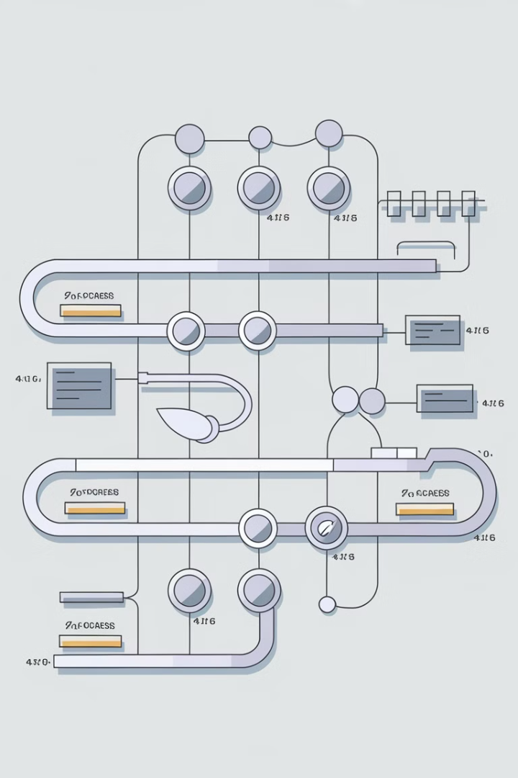
Metrics for Testing
Cyclomatic Complexity (CC)
Cyclomatic Complexity is a quantitative metric that measures the complexity of a program's control flow. Modules with high cyclomatic complexity are more likely to be error-prone. And more testing efforts will be needed
CC=E−N+2
E: Number of edges in the control flow graph.
N: Number of nodes in the control flow graph.

Slide 24
Metrics for Testing
Cyclomatic Complexity (CC)
int x = 0;
if (x > 0) {
x = x + 1;
} else {
x = x - 1;
}
Start
int x = 0
if (x > 0)
True
False
CC = E−N+2
= 6 – 6 + 2
= 2
x = x + 1
x = x - 1
End

Slide 25
OO Testing Metrics
LCOM (Lack of Cohesion in Methods)
Definition: Measures the degree of relatedness between methods in a class.
Reason: Higher LCOM indicates more states, increasing the likelihood of side effects.
Impact: More extensive testing is needed to ensure side effects are avoided.
PAP (Percent Public and Protected)
Definition: Indicates the percentage of public and protected attributes in a class.
Reason: High PAP increases coupling, leading to greater risk of side effects.
Impact: Testing must uncover unintended interactions among classes.
PAD (Public Access to Data Members)
Definition: Measures the number of external classes accessing a class's attributes.
Reason: High PAD violates encapsulation, increasing the risk of side effects.
Impact: Tests must address potential cross-class side effects.

Slide 26
OO Testing Metrics
NOR (Number of Root Classes)
Definition: Counts the distinct class hierarchies in the design model.
Reason: As NOR increases, the complexity of testing each hierarchy grows.
Impact: More root classes mean more effort in creating comprehensive test suites.
FIN (Fan-In)
Definition: Measures the number of parent classes a class inherits from.
Reason: FIN > 1 (Multiple inheritance) increases complexity and risks ambiguity.
Impact: Should be avoided; simplifies testing and design.
NOC & DIT (Number of Children & Depth of Inheritance Tree)
Definition: NOC: Number of immediate subclasses; DIT: Levels in inheritance tree.
Reason: Deep inheritance and numerous subclasses require retesting of superclass methods.
Impact: Increases testing workload for each additional layer or subclass.

Slide 27
Metrics for Software Quality
The primary goal of software engineering is to produce high-quality systems, applications, or products that meet market needs within a specified timeframe. This requires applying effective methods, modern tools, and mature software processes. Measurement is crucial for assessing and achieving high quality across all aspects of software development, from requirements to testing.

Slide 28
Measuring Quality
Correctness
Maintainability
Degree to which the software performs its required function.
The most common measure for correctness is defects per KLOC
Defect Density per KLOC = number of verified defects (bugs or errors) in the software per 1,000 lines of code
the ease with which a program can be corrected, adapted, or enhanced
A simple time-oriented metric is mean-time-to-change (MTTC)
MTTC = average time required to implement a change
Integrity
Usability
system’s ability to withstand attacks to its security
Integrity=1−(threat×(1−security))
Threat -> probability that a specific type of attack will occur, Security -> probability an attack will be repelled
ease of use with which users can achieve their goals

Slide 29
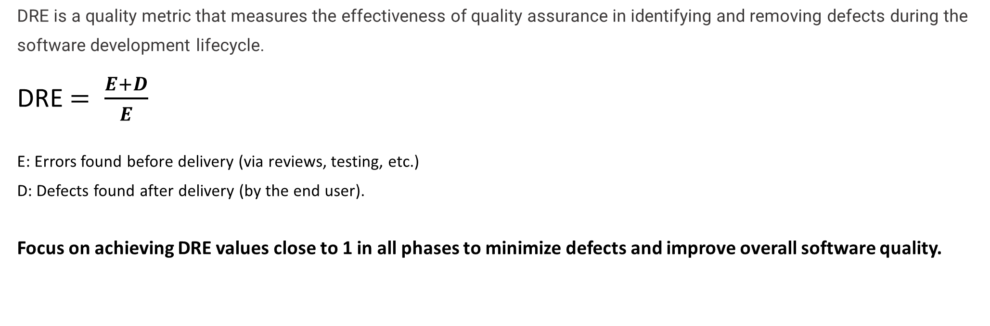
Defect Removal Efficiency (DRE)

Slide 30
Reference
Chapter 23 – Product Metrics
Chapter 25.3 – Metrics for Software Quality Software Engineering A Practitioner’s Approach, R. Pressman

Slide 31
THANK YOU

